Slide 1

Democratizing & Accelerating AI Through Automated Machine Learning
AI Platform Team
#AIGlobalNight
global.ainights.com

Slide 2

Agenda
Welcome Video
Why Automated Machine Learning
Automated ML Capabilities
How to Get Started

Slide 3

Welcome Video

Slide 4
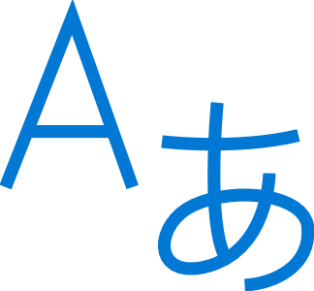





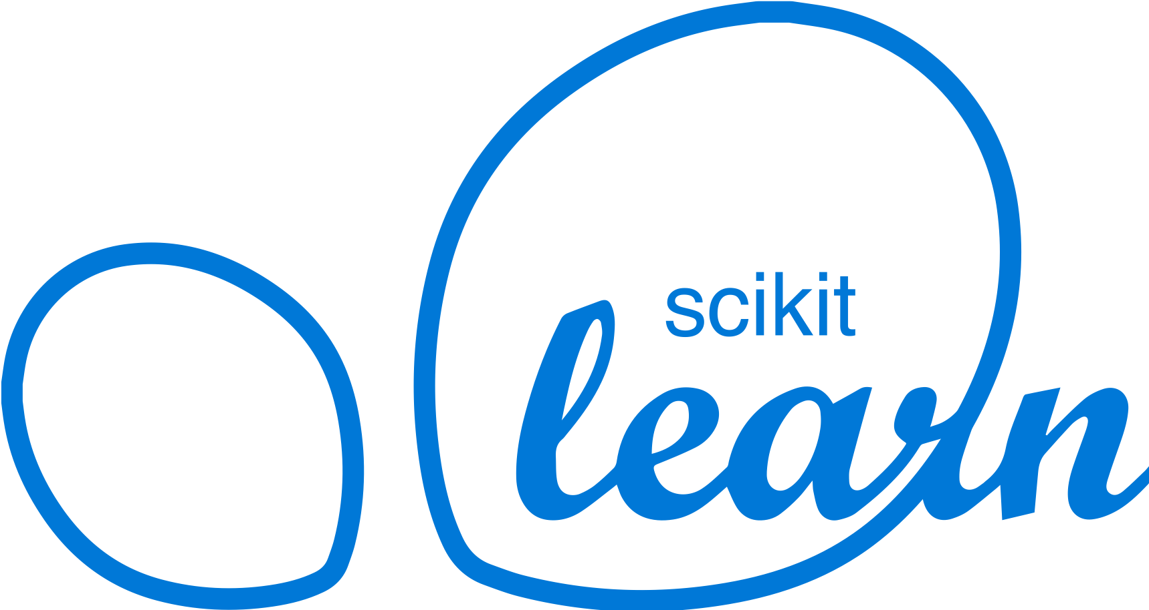

Machine Learning on Azure
Domain Specific Pretrained Models
To reduce time to market
…
Vision
Speech
Language
Search
Familiar Data Science Tools
To simplify model development
PyCharm
Jupyter
Visual Studio Code
Command line
Popular Frameworks
To build machine learning and deep learning solutions
PyTorch
TensorFlow
Scikit-Learn
ONNX
Productive Services
To empower data science and development teams
Azure Databricks
Azure Machine Learning
Azure Machine Learning
Machine Learning VMs
Powerful Hardware
To accelerate deep learning
CPU
GPU
FPGA
From the Intelligent Cloud to the Intelligent Edge
Notes:
Azure has a lot of machine learning abilities, Azure machine learning service is a platform to facilitate the entire machine learning workflow under one roof, while keeping the solution as flexible and customizable as possible.

Slide 5
Building blocks for a Data Science Project
Build and train models
Hyperparameter tuning
Experimentation and pipelines
Deployment
DevOps for data science
Classical ML
Data sources
Deep learning

Slide 6

What is automated machine learning?
Automated machine learning (automated ML) automates feature engineering, algorithm and hyperparameter selection to find the best model for your data.

Slide 7
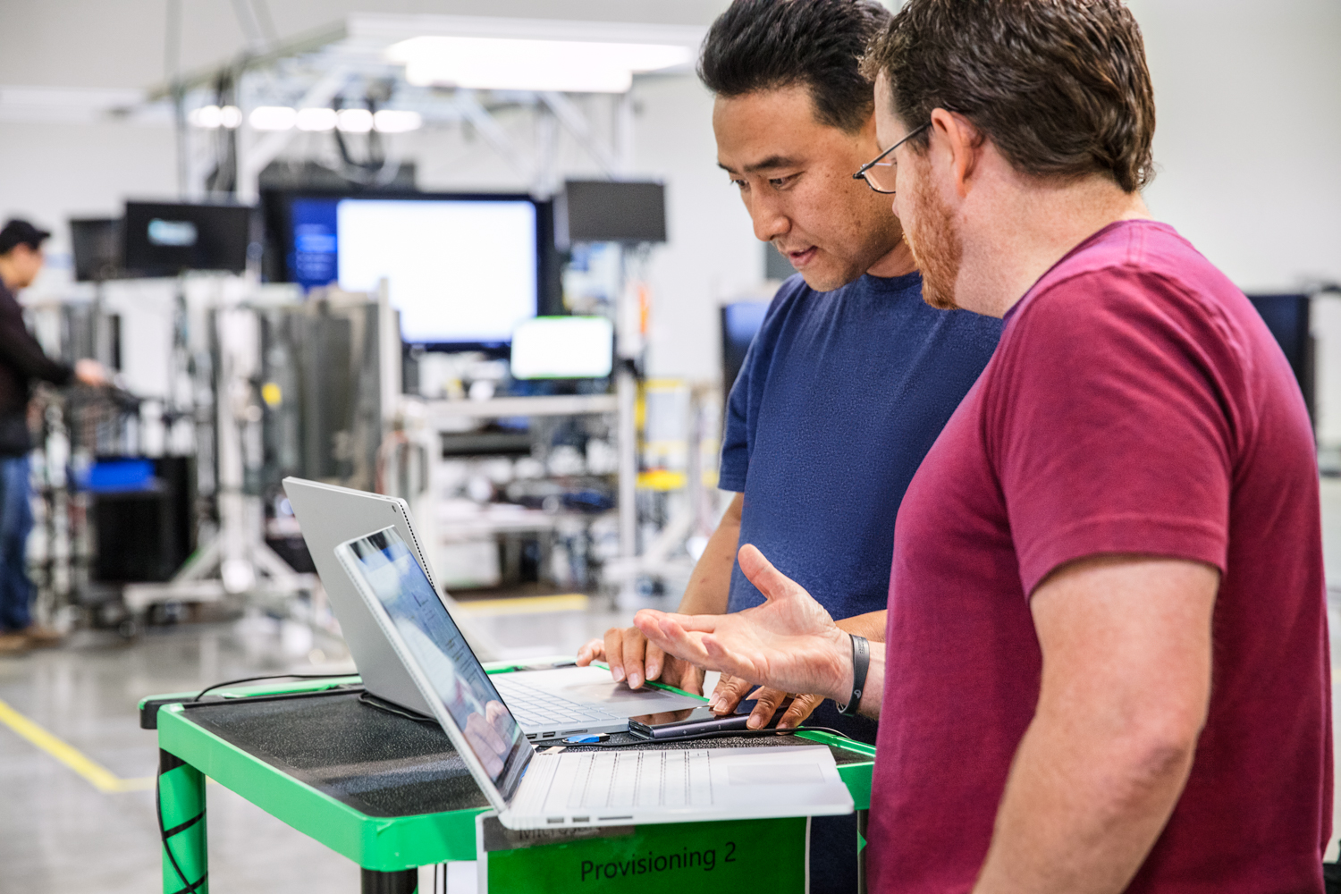

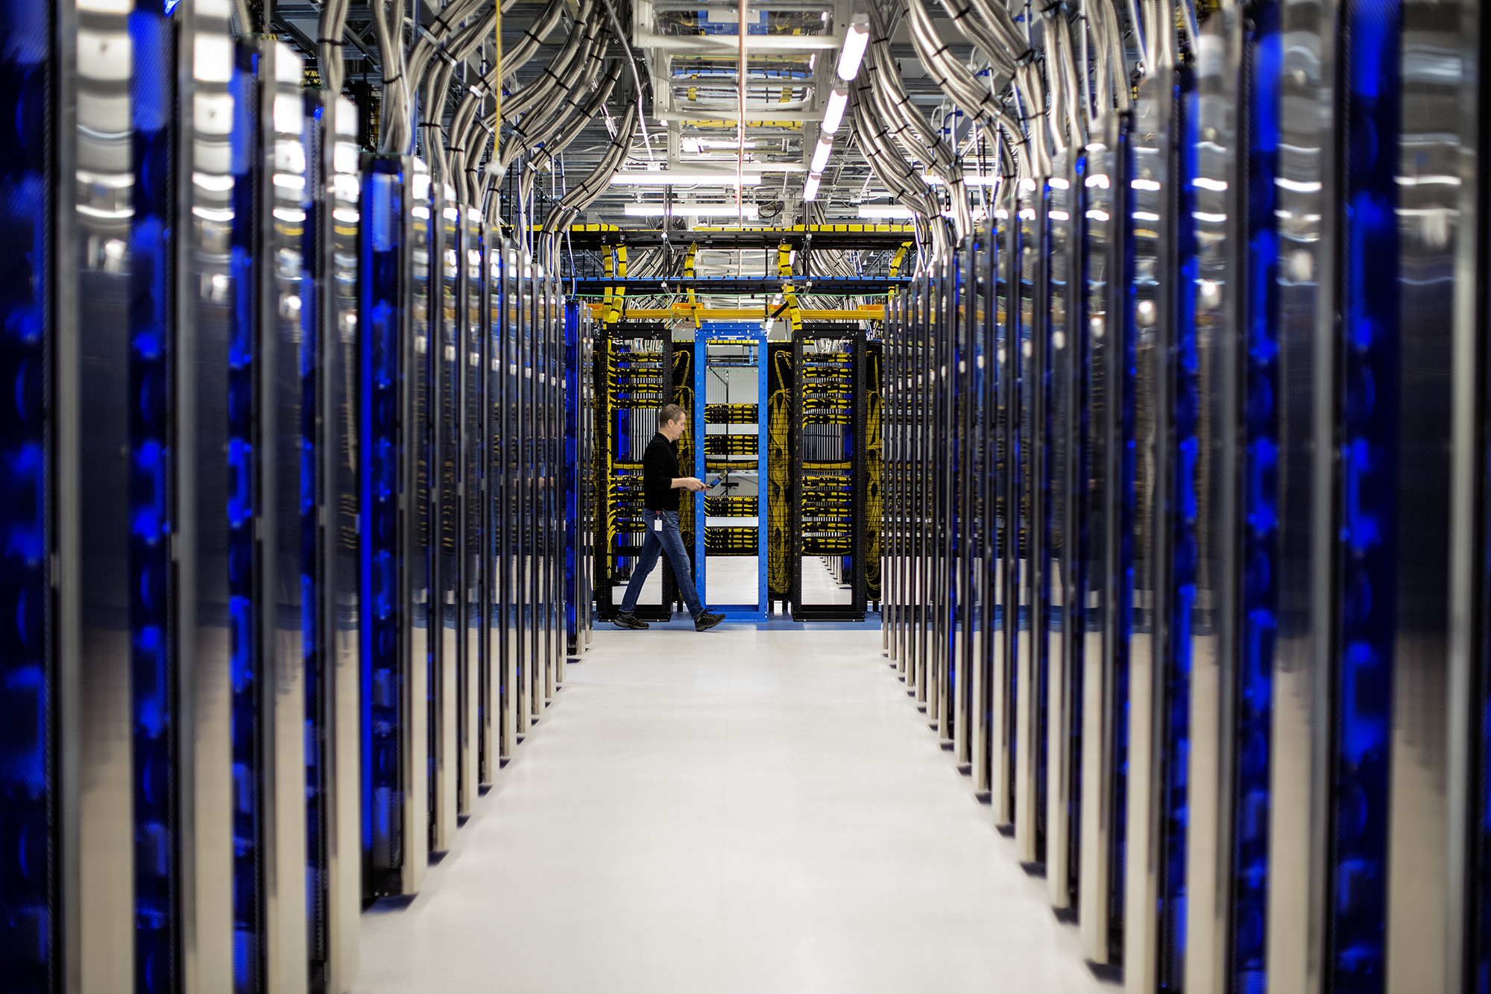
Automated ML Mission
Enable automated building of machine learning with the goal of accelerating, democratizing and scaling AI
Democratize AI
Accelerate AI
Scale AI
Enable Domain Experts & Developers to get rapidly build AI solutions
Improve Productivity for Data Scientists, Citizen Data Scientists, App Developers & Analysts
Build AI solutions at scale in an automated fashion
Notes:
Once you have your data source and format defined. You need to consider how you want the experiment to split your train, test and validation data. Automated ML supports three types.
K-fold
Monte Carlo or repeated random sub-sampling
Manual or custom splits.
K-Fold
For k-fold use n_cross_validations setting to specify the number of cross validations. The training data set will be randomly split into n_cross_validations folds of equal size. During each cross-validation round, one of the folds will be used for validation of the model trained on the remaining folds. This process repeats for n_cross_validations rounds until each fold is used once as validation set. The average scores across all n_cross_validations rounds will be reported, and the corresponding model will be retrained on the whole training data set.
Monte Carlo
Use validation_size to specify the percentage of the training dataset that should be used for validation, and use n_cross_validations to specify the number of cross validations. During each cross validation round, a subset of size validation_size will be randomly selected for validation of the model trained on the remaining data. Finally, the average scores across all n_cross_validations rounds will be reported, and the corresponding model will be retrained on the whole training data set.
Custom Validation Dataset
Use custom validation if random split is not acceptable (usually time series data or imbalanced data). You can specify your own validation dataset. The model will be evaluated against the validation dataset specified instead of random dataset. If you are using custom splits you split you would split your data based on your requirements and pass your training data into the x and y parameters and x_valid and y_valid for validation data.

Slide 8
Machine Learning Problem Example
How much is this car worth?

Slide 9
Model Creation Is Typically Time-Consuming
Which features?
Which algorithm?
Which parameters?
Mileage
Condition
Car brand
Year of make
Regulations
…
Gradient Boosted
Nearest Neighbors
SVM
Bayesian Regression
LGBM
…
Parameter 1
Parameter 2
Parameter 3
Parameter 4
…
Mileage
Gradient Boosted
Criterion
Loss
Min Samples Split
Min Samples Leaf
Others
Car brand
Year of make
30%
Model

Slide 10
Model Creation Is Typically Time-Consuming
Which features?
Which algorithm?
Which parameters?
Mileage
Condition
Car brand
Year of make
Regulations
…
Gradient Boosted
Nearest Neighbors
SVM
Bayesian Regression
LGBM
…
Criterion
Loss
Min Samples Split
Min Samples Leaf
Others
Mileage
Gradient Boosted
N Neighbors
Weights
Metric
P
Others
Condition
Nearest Neighbors
Car brand
Car brand
50%
Year of make
30%
Year of make
Model
Iterate

Slide 11
Model Creation Is Typically Time-Consuming
Which features?
Which algorithm?
Which parameters?
30%
50%
70%
30%
45%
50%
65%
95%
35%
10%
75%
20%
70%
30%
15%
Iterate

Slide 12
Automated ML Accelerates Model Development
Input
Intelligently test multiple models in parallel
Output
25%
Optimized model
25%
40%
Enter data
70%
25%
40%
70%
95%
95%
Define goals
25%
40%
70%
25%
40%
25%
70%
Apply constraints
40%

Slide 13

Automated Machine Learning Under the Hood
User inputs
Feature engineering
Algorithm selection
Hyperparameter tuning
Model Leaderboard
Rank | Model | Score
1 |  | 95%
2 |  | 76%
3 |  | 53%
Dataset
76% | 34% | 82%
41% | 88% | 72%
81% | 54% | 73%
88% | 90% | 91%
95% | 68% | 56%
89% | 89% | 79%
…
Configuration & Constraints
Notes:
This is where Automated machine learning comes handy, and automates that process for us, all you have to do is bring the data, configure a few settings and constraints to the process, like limiting the time you allow it to run, for example, and then Automated machine learning will run and generate many models and rank them based on their accuracy metric, so that you can choose the best performing model. The process is transparent and customizable.

Slide 14
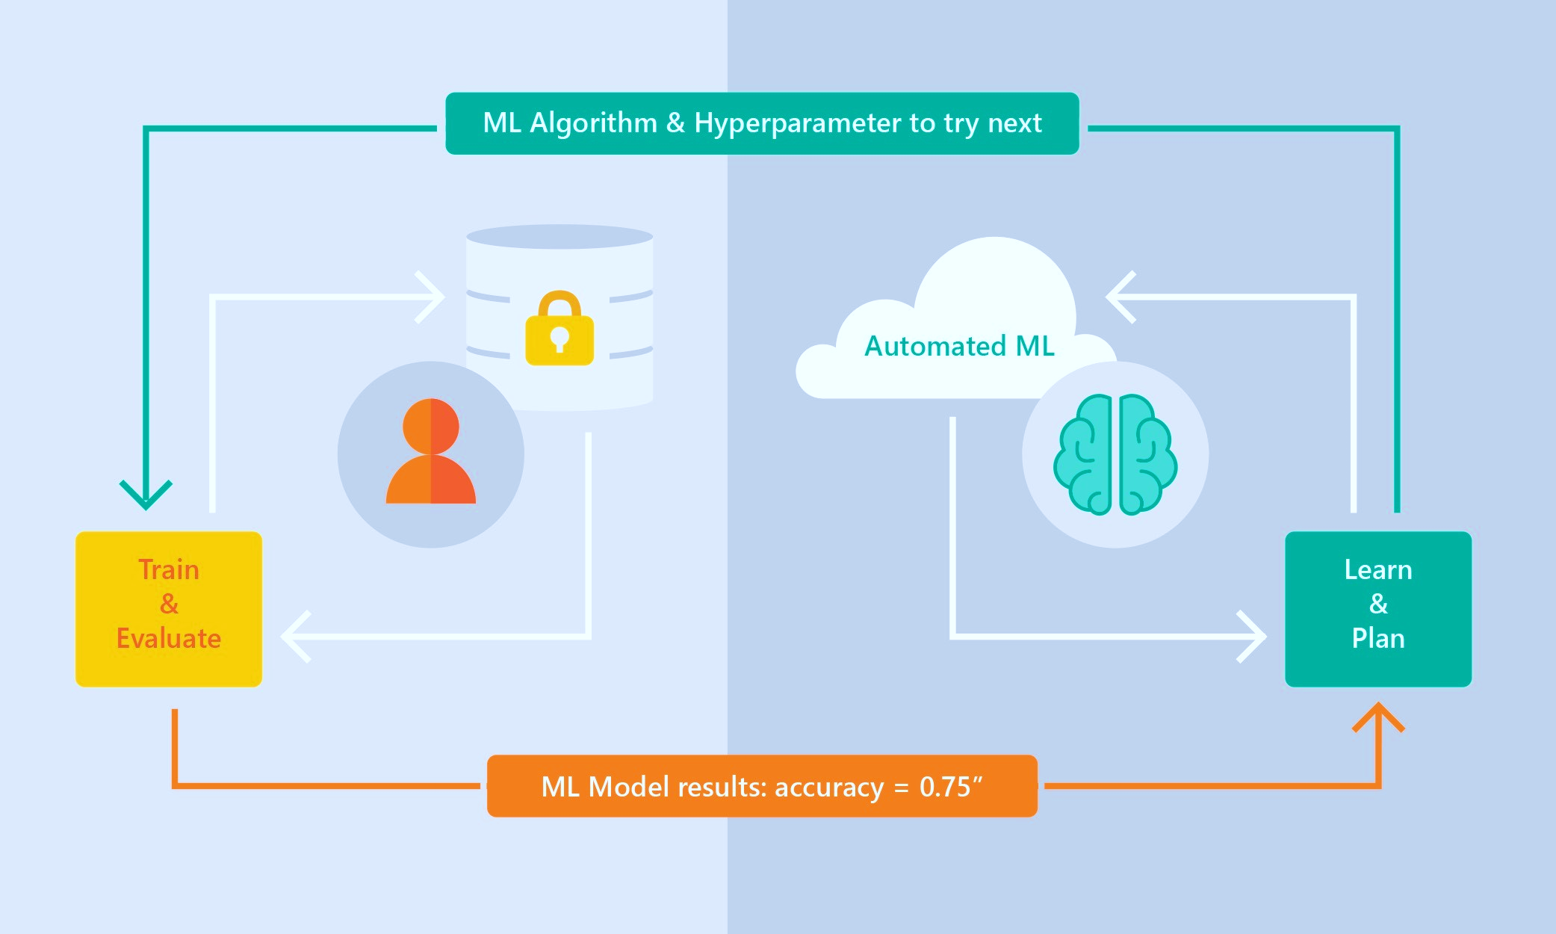



Automated Machine Learning Capabilities
Based on Microsoft Research
Brain trained with several million experiments
Personalized recommendation approach:
Collaborative filtering and Bayesian optimization
Privacy preserving: No need to “see” the data
Supervised Learning
Classification
Regression
Time Series Forecasting
Notes:
What differentiates the solution is the brain of the system, which is based on a research from Microsoft Research. The idea is that a model is trained based on millions of dataset characteristics like size, number and type of columns. and then recommending which algorithm and hyperparameters to use when it sees new datasets. It is a meta-model trained to predict which model to use. I like to think of it as the Netflix of machine learning models – where based on knowledge of previous datasets, the meta-model knows which models to recommend for your data. All this without actually looking at the data itself, so privacy is preserved. The point is, eventually, to help the process converge much faster than just going over all the possibilities randomly. This saves time and money.

Slide 15
Automated ML Capabilities
ML Scenarios: Classification & Regression, Forecasting
Languages: Python SDK for deployment and hosting for inference – Jupyter notebooks
Training Compute: Local Machine, AML Compute, Data Science Virtual Machine (DSVM), Azure Databricks*
Transparency: View run history, model metrics, explainability*
Scale: Faster model training using multiple cores and parallel experiments
* In Preview

Slide 16
Guardrails: Detection and auto-correction of data issues
Class imbalance
Train-Test split, CV, rolling CV
Missing value imputation
Detect high cardinality features
Detect leaky features
Detect overfitting

Slide 17

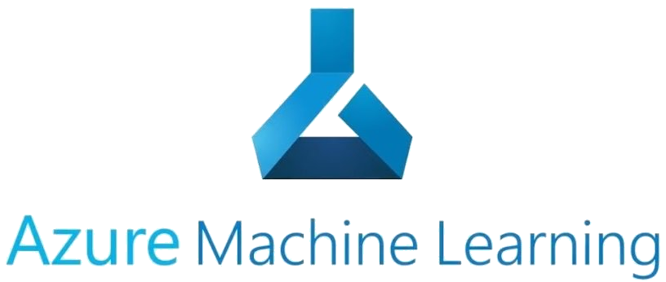







Machine Learning for Everyone
Automated Machine Learning
Data Scientist
Data Engineer
Developer
Data Analyst
Citizen Data Scientist
Notes:
So how do you get started? Automated machine learning is for everyone who is working with data. If you are a data scientist, you will be comfortable using the Python SDK in Jupyter notebook, and you’ll be able to use Jupyter notebooks from the Azure machine learning service. If you are a citizen data scientist, or if you just started making your way as a data scientist, or if you prefer graphical user interface over coding, you can use the Automated machine learning web user interface in Azure machine learning service, and start a training job within just a few clicks of a button. If you are a data analyst, business analyst, or data engineer, you can use the integrations with Power BI, Alteryx, and SQL Server, to train and predict directly from the tools that you are already using on a daily basis. If you are a developer, you can use Automated machine learning in Visual Studio with the ML.NET library, or you can code directly with Python.

Slide 18










Customer Testimonials
With one line of code, it runs through different algorithms within the prediction family and the different parameter (or variable) combos that previously were manually tested by the scientists. The power of the cloud comes in here. The results are comparable to what the data scientists produced.
Manish Naik, BP, Digital Innovation
The reason we see the sharp uplift in sales is the customers are getting content that really connects with them, and they're getting offers for things that are truly relevant and relevant at that moment in time…. Microsoft—they are really wanting to be our partners and were really going to help us on this journey, which was very differentiating
Daniel Humble, Chief Data and Analytics Officer, Walgreens Boots Alliance
If I have 200 models to train—I can just do this all at once. It can be farmed out to a huge computer cluster, and it can be done in minutes so I'm not waiting for days or setting experiments to run over the weekend anymore.
Dean Riddlesden, Senior Data Scientist, Walgreens Boots Alliance
Auto ML’s execution of different models was an impressive that enabled data scientists to work iteratively on machine learning experiments to increase auction sales by 10% and optimize the time auction cars are kept in the showroom to less than 30 days.
Farika Maharani, PT. Serasi Autoraya, Data Platform Supervisor
The CBRE AI and Data Engineering Team have successfully deployed a complete Azure Machine Learning model to their new API gateway leveraging the Azure AutoML solution in Azure Databricks. The API Gateway plus the model deployment goes into production this March.
Francis Dogbey, Microsoft CSA
With automated machine learning in Azure Machine Learning service, we can focus our testing on the most accurate models and avoid testing a large range of less valuable models, because it retains only the ones we want. That saves months of time for us.
Matthieu Boujonnier: Analytics Application Architect and Data Scientist, Schneider Electric
Models evolve over time. And we use automated machine learning to speed that process, from four months for our first-generation models to a day for our newest models.
Loryne Bissuel-Beauvais: Data Scientist, Schneider Electric
In evaluating Azure Automated ML we discovered real potential in shortening the time to market for producing predictive models. The availability of the Automated ML UI also holds the promise of opening the ML space to non data science trained resources which in turn allows the democratizing of the predictive work without the pain of hiring expensive/ hard to retain staff.
Bogdan Rosca, Senior Director, Principal Information Architect
We tried AutoML for aspect ratio model and pleased to see AutoML produced much better model than our baseline. We need to build almost 50 models and are looking forward to the productivity boost we will get by not hand tuning each one of them!
Saurabh Naik, Sr. Software Engineer
We see advantages moving over to Azure AutoML because we think we will be able to increase our speed to create models significantly and do more with less in terms of labor hours.
Dan Metzendorf, Data Science Manager, The Sherwin Williams Company
AutoML resulted in a significant improvement in model performance (1) Consistently produced better models than other automated ml libraries (TPOT) (2) Also outperformed hand-tuned models. AutoML explored a solution space larger than what was plausible to do manually
David Robinson, Devon Energy Data Scientist
Teams uses machine learning to analyze, gain insights and improve the quality of calls. We use AutoML to significantly scale up the application of ML solutions by semi-automating model train tasks

Slide 19
What’s new?

Slide 20
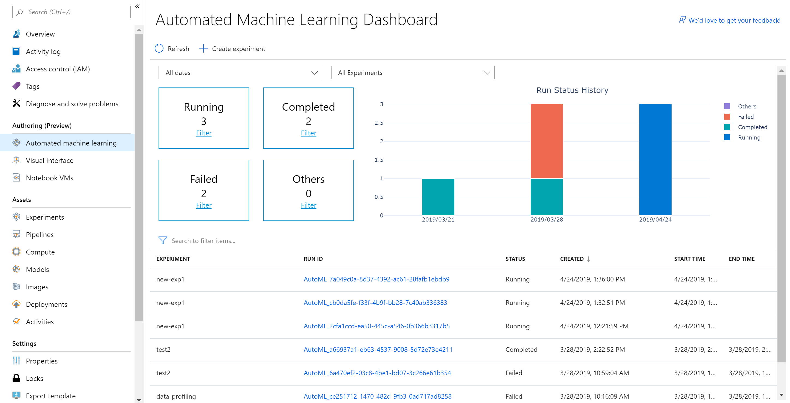
Latest announcements (Blog post with all the announcements)
Automated ML UI in Azure portal (Preview)
End-to-end no-code experience for non-data scientists to train ML models
Classification, Regression, Forecasting
Deploy models easily and quickly
Advanced settings for power users to tune the training job
Blog post
Coming up next
Model explainability
Additional data sources (with Datasets)
Re-run experiments

Slide 21

Latest announcements (Blog post with all the announcements)
Time Series Forecasting Generally Available
Rolling cross validation splits for time series data
Configurable lags
Window aggregation
Holiday featurizer

Slide 22
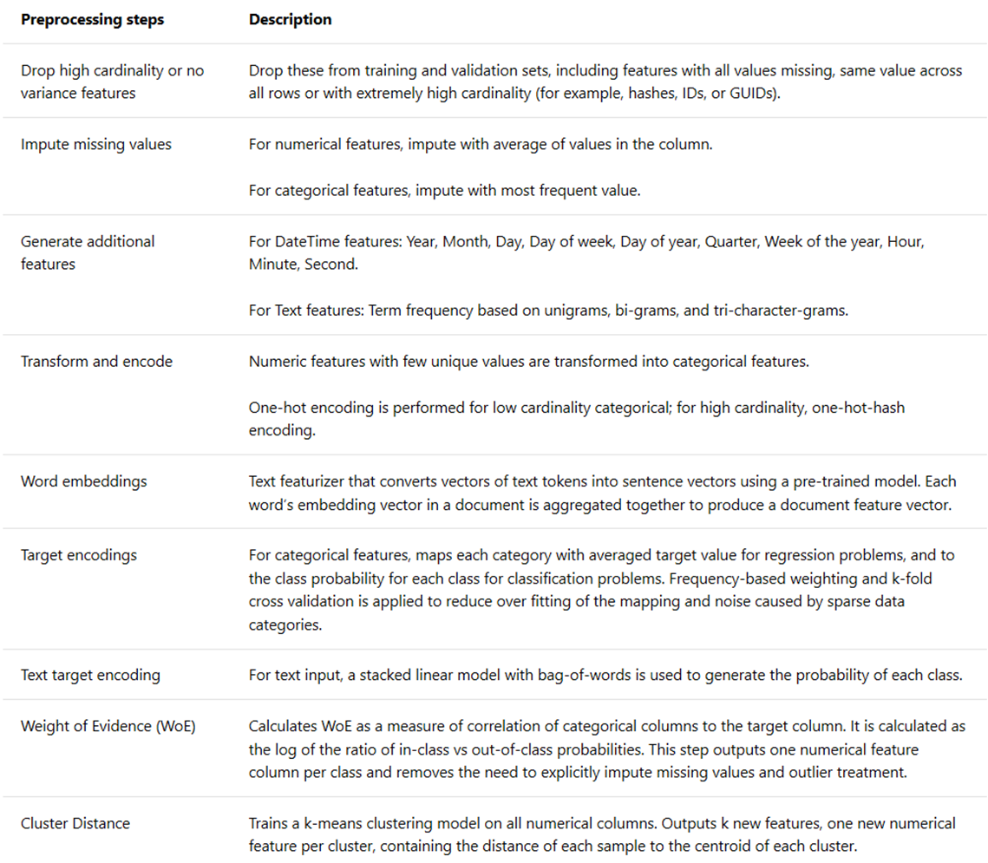
Latest announcements (Blog post with all the announcements)
Feature engineering updates
Additional data guardrails and synthetic features
Added XGBoost algorithm
Improved transparency retrieving the engineered features
Coming up next
Improved feature sweeping, text featurization
Transparency: Get auto-featurized data

Slide 23

Workshop
Prerequisites
1. Azure Subscription
2. Azure ML workspace

Slide 24
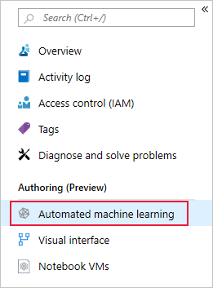
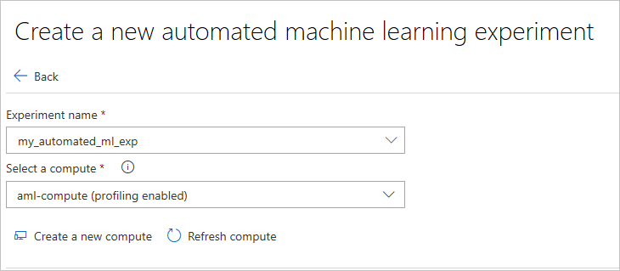
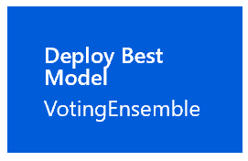
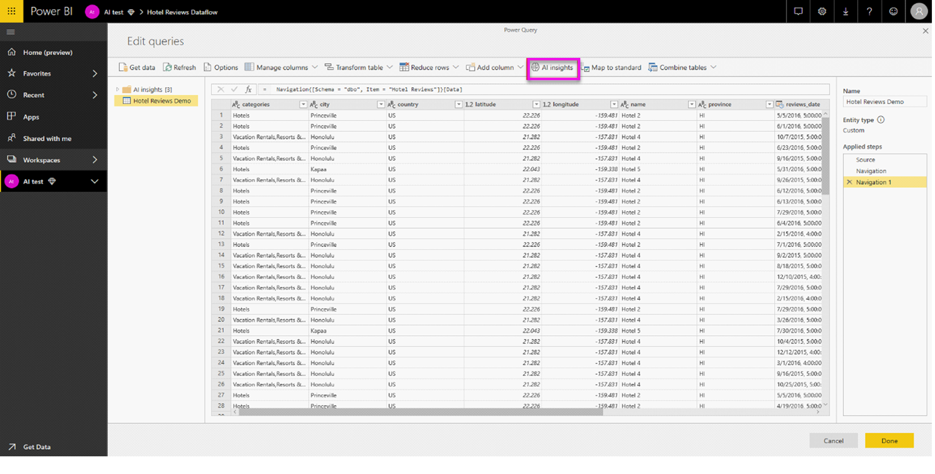
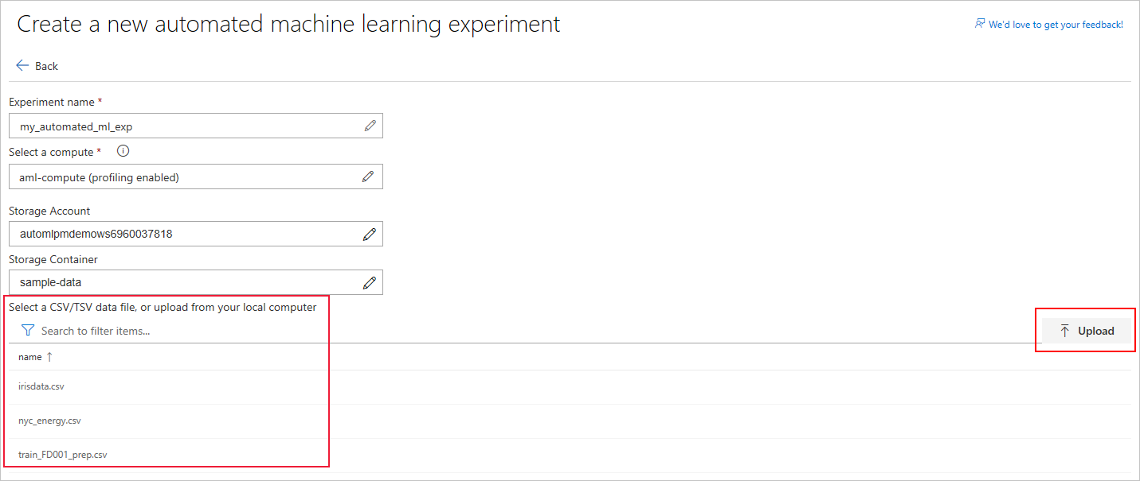
Automated ML using Azure Portal UI: Car price prediction
Follow instructions: https://docs.microsoft.com/en-us/azure/machine-learning/service/how-to-create-portal-experiments
Navigate to the left pane of your workspace. Select Automated Machine Learning under the Authoring (Preview) section.
Preview data and keep all columns selected for training
Select the training job type: regression
Select target column: price
Open “Advanced settings”, set training job time to 10 minutes (for the sake of the workshop)
Enter your experiment name, then select a compute from the list of your existing computes or create a new compute
Hit
Start
And wait for the training job to start. You’ll be able to see the models which are created during the run
Once the run is completed, click deploy the best model
Use the following scoring script and conda file to override the auto-generated files to enable consumption from Power BI
Select a data file from your storage container, or upload a file from your local computer to the container
Car price dataset downloadable from:
https://automlpmdemows6960037818.blob.core.windows.net/sample-data/Automobile price data.csv
Once deployed, follow instructions to consume from Power BI

Slide 25
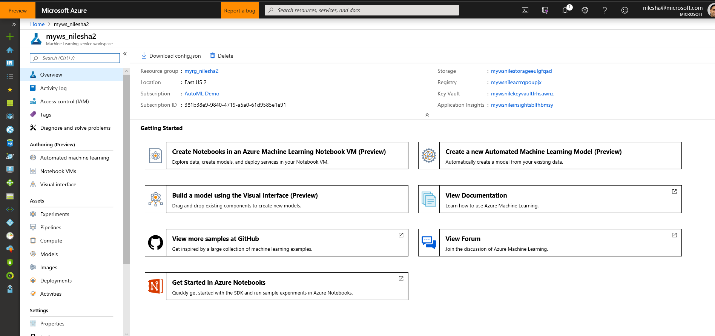
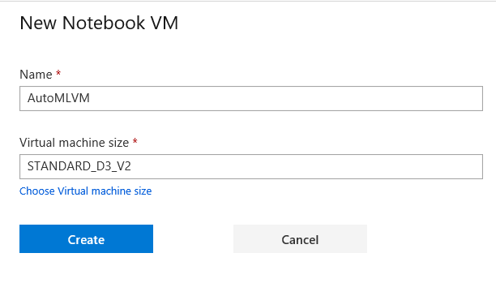
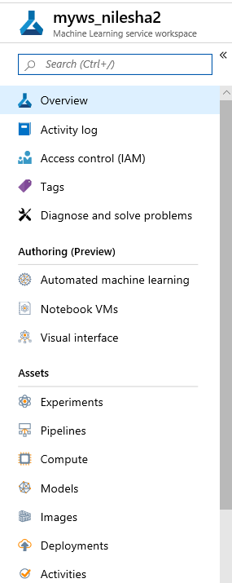
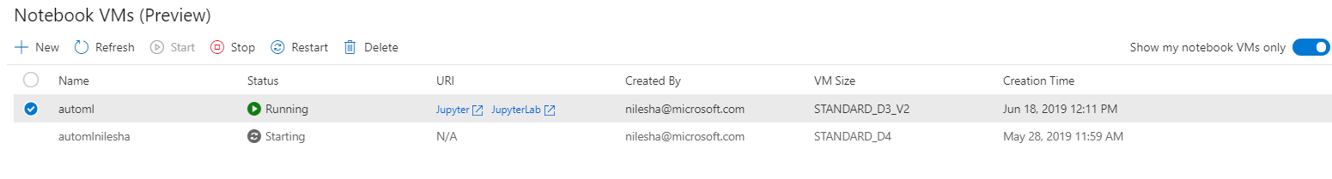
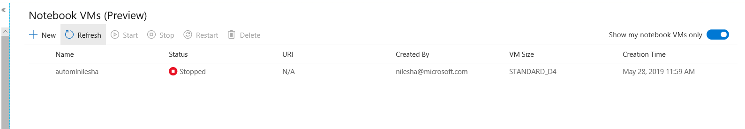
1. Login into Azure Portal : https://ms.portal.azure.com/#home 2. Open your Machine Learning Service Workspace. 3. Click on Notebook VM 4. Click “New”. If you have an existing VM go to step 6
Automated ML using Notebook VM : Energy Demand
5. Name your VM and select machine size and click on create
6. After VM has started (~10mins) click on Jupyter link
7. Click on root folder > Samples-x.x.xx > how-to-use-azureml > automated-machine-learning > forecasting-energy-demand > /auto-ml-forecasting-energy-demand.ipynb 8. Follow instructions in notebook executing each cell.

Slide 26


Resources http://aka.ms/amlfree
Learn more : https://aka.ms/automatedmldocs
Notebook Samples : https://aka.ms/automatedmlsamples
Blog Post : https://aka.ms/AutomatedML
Product Feedback : AskAutomatedML@microsoft.com
Notes:
Choose between visual drag-and-drop or code-first authoring with complete control
Use your favorite IDE, built into your favorite IDE (VS Code only @ Public Preview)
Use any framework or library and the most popular languages
Faster, easier training on industry leading Spark

Slide 27
Thank You!
AI Platform Team

